Slide 1
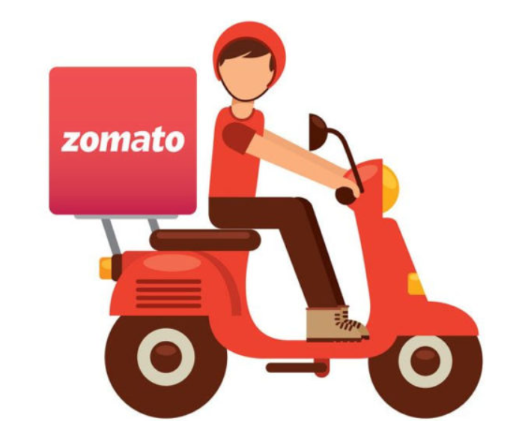
Zomato Data Analysis
Akshay Kishor

Slide 2
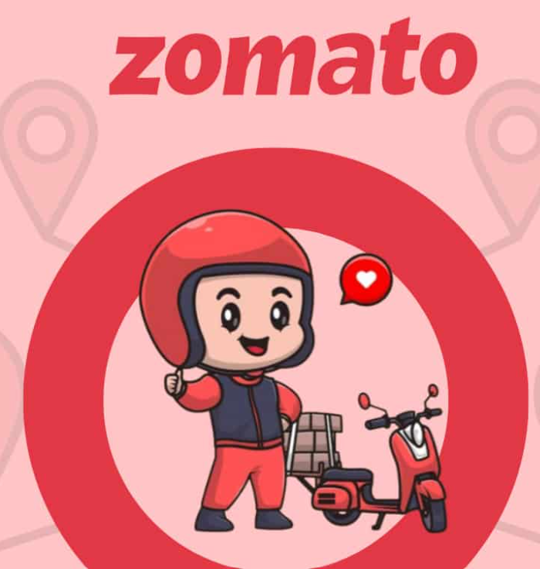




Contents
About Zomato
Insights
Data Clean up
New Restaurant Suggestions
Dashboard

Slide 3

About Zomato
Zomato is an Indian multinational food delivery service.
Founded in 2008 by Deepinder Goyal and Pankaj Chaddah.
It allows users to discover and order food from a wide variety of local restaurants.

Slide 4

Problem Statement
Where should new restaurants be opened?
What factor impacts the ratings of restaurants?
Should the restaurant has Table Booking & Online delivery options?
What should be the expenditure for new restaurants?

Slide 5

Unlocking Insights – Data Peek
Data consisted of 9,542 restaurants spread across 15 countries world wide.
Having ratings against each restaurants along with price range varying from 1 to 5
Each restaurant had a cuisine – in total there were 1,825 cuisines across the data

Slide 6

Data Cleanup Approach & Tools Used
In column “Datekey_Opening” values “_” was replaced by “-“
There were 9 cases in Cuisines column which were BLANKs.
To avoid any misleading information, I have deleted these line items as they contributed only 0.001% of the entire dataset.

Slide 7
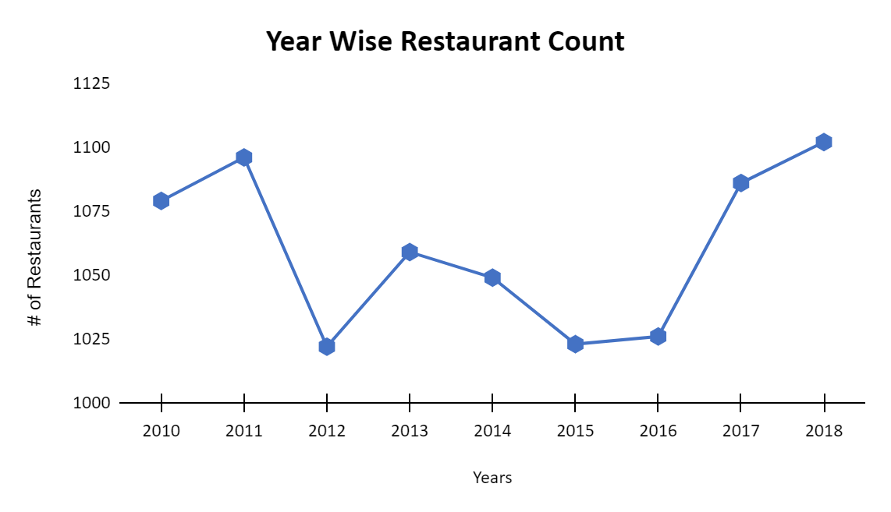
Year Wise Restaurant Count
2018 was the year with most count of restaurants opened
On an average every year around 1000 restaurants are opening

Slide 8
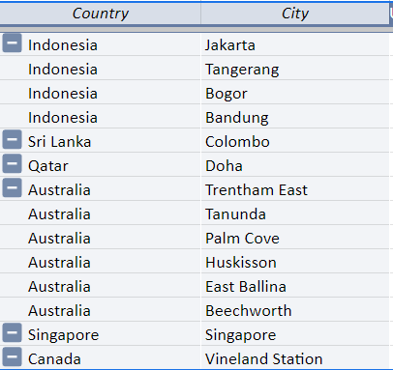
New Restaurant Openings : City Insights
Target cities should be such wherein competition is less.
Hence the filter used to identify such cities were
as follows:
Greater than 4 rating
Less than 10 restaurants
With this filter 6 countries can be the target points and cities in these countries are shown in image.

Slide 9
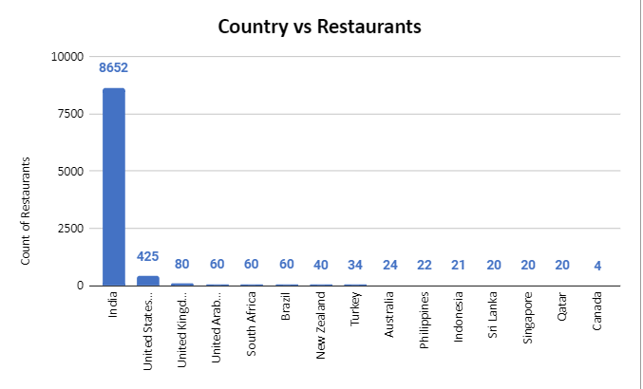
Country Wise Restaurant Count
Total Restaurant count is 9542
India has the most # of restaurants with 8652 restaurants
Followed by USA which has 425 restaurants

Slide 10
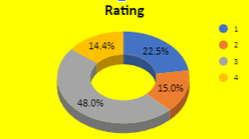
Rating
Most of restaurants are rated 3 – which consists of 48% of overall restaurant count
Followed by 1 rates restaurants – in total they contribute to more than 70% of restaurants

Slide 11
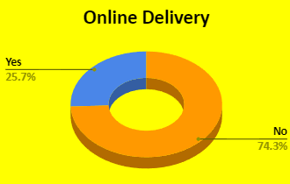
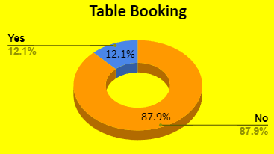
Table Booking & Online Delivery Impact
Online Delivery option in not available in more than 74% of restaurants
Table Booking option in not available in more than 87% of restaurants
Both these features have negligible impact on ratings as well

Slide 12
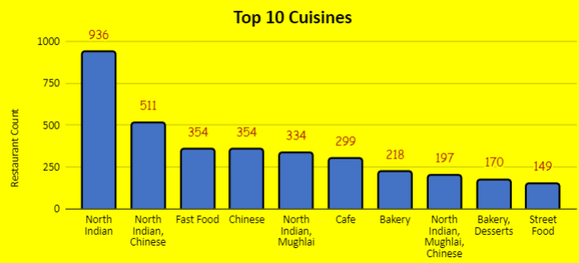
Top 10 Cuisines
North Indian is the cuisine used in most number of restaurants
Followed by North Indian, Chinese Cuisine

Slide 13
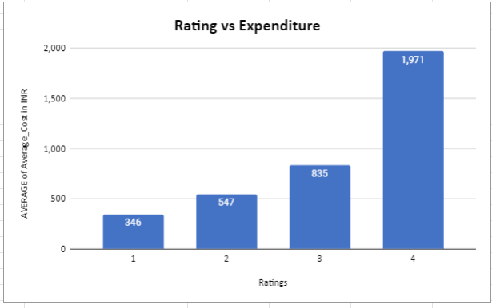
Expenditure Analysis
Ratings and expenditure are corelated.
High rated restaurants attracts heavy expenditure

Slide 14

Recommendation
Locations where we have less count of high rated restaurants should be our focus.
Ratings of restaurants are impacted by expenditure and cuisines – high rated cuisines and above average expense should be our target
Table Booking & Online Delivery is not necessary, they have not impact on ratings
Average Cost for Two should be greater than 1000 INR to ensure good rated restaurant

Slide 15
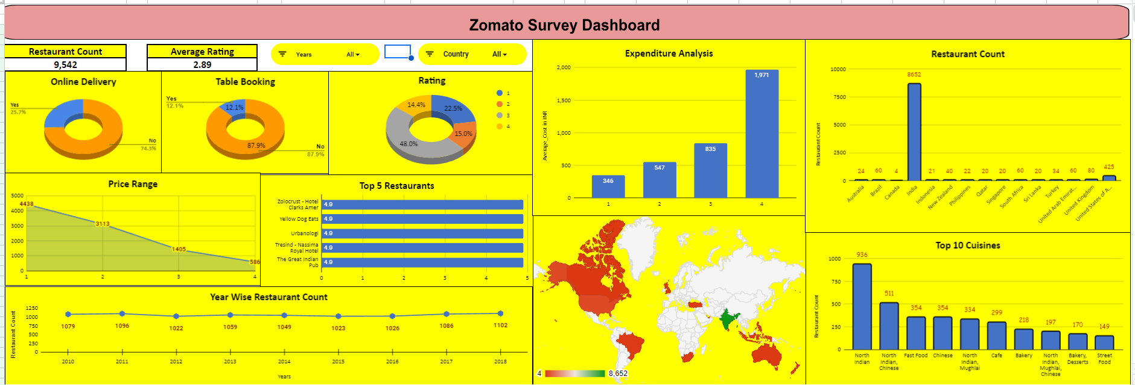

Slide 16

As conclusion – we can be sure that features like Online Delivery and Table Booking does not impact the ratings.
Price range has a direct impact on rating.
2018 had highest number of restaurants
India leads the restaurant count dataset by an heavy margin

Slide 17
THANK YOU

